Slide 1
Keiretsu and Economic Growth
Ashish Gokarnkar
Abdul Ahadh
Ankit Pandey
Notes:
Background
<a href="https://www.freepik.com/free-photos-vectors/business">Business vector created by pikisuperstar - www.freepik.com</a>
Cheery Blossom
<a href="https://www.freepik.com/free-photos-vectors/banner">Banner vector created by freepik - www.freepik.com</a>

Slide 2
Keiretsu
- Ankit Pandey
A business network made up of different companies which maintain close relationships and encourage crossholdings of equity stakes while remaining operationally independent.
Horizontal
Vertical
i
Notes:
Gate
<a href="https://www.freepik.com/free-photos-vectors/flower">Flower vector created by macrovector - www.freepik.com</a>
Background
<a href="https://www.freepik.com/free-photos-vectors/banner">Banner vector created by macrovector - www.freepik.com</a>
Cheery Blossom
<a href="https://www.freepik.com/free-photos-vectors/banner">Banner vector created by freepik - www.freepik.com</a>

Slide 3
Structure of Keiretsu
Automotive
Construction and Heavy Machinery
Transportation and Warehousing
Electrical and Machinery
Central Bank
Trading and Commerce
Foods
Insurance Company
Real Estate Company
Finance and Insurance
Fiber and Textile
Iron/ Steel

Slide 4

Meiji Restoration
“Japanese Miracle”
Economy showed recovery
Open policy & introduced technology
High economic growth; export-oriented economy
Modern Japan
1868
1960 – 1980
2005
1945 - 1952
1990
Economic History
Occupied Period after WW II
High Growth Turned Slow
Occupation force brought new technologies and research

Slide 5

Keiretsu Working Culture
Enterprise Unions
Lifetime Employment
Rotation
Seniority Wages
Work Centric
Notes:
Background
<a href="https://www.freepik.com/free-photos-vectors/background">Background vector created by freepik - www.freepik.com</a>
Cheery Blossom
<a href="https://www.freepik.com/free-photos-vectors/banner">Banner vector created by freepik - www.freepik.com</a>

Slide 6

Keiretsu Working Culture
Lifetime Employment
Enterprise Unions
Keiretsu
Working Culture
Rotation
Seniority Wages
Work Centric

Slide 7
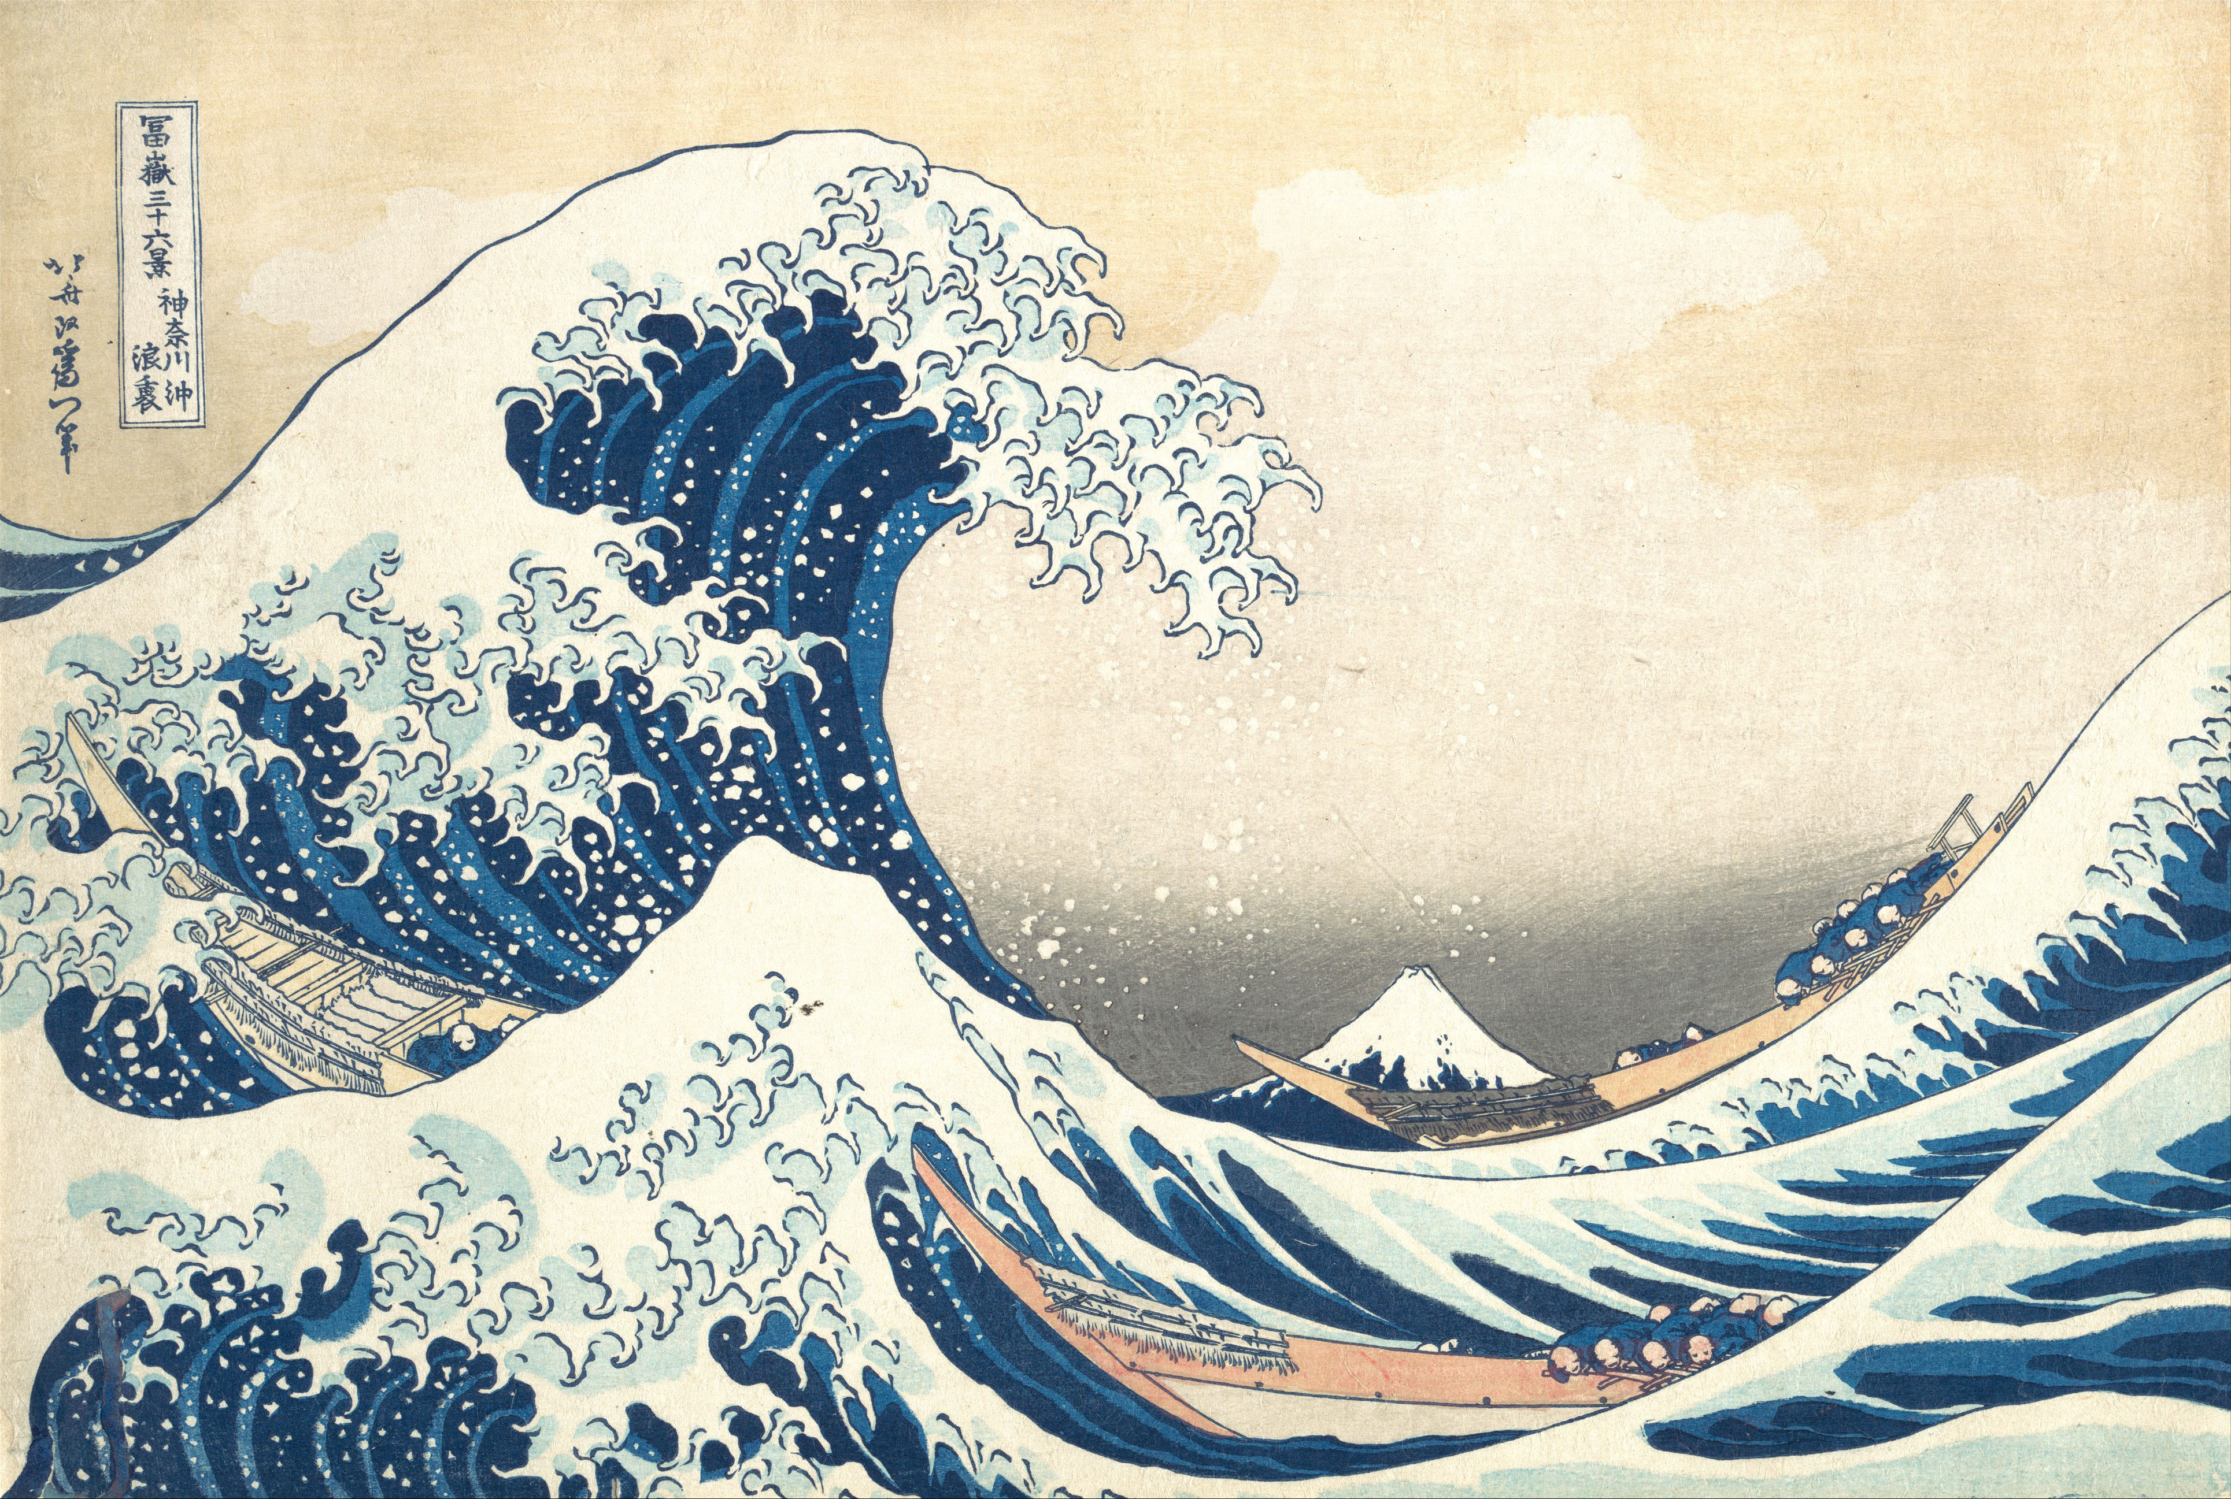
Japanese Economy
Less Economic Inequality
Hard Budget Constraints
Neo - Confucion
Cooperative Union
Concentrated
Long term Vision

Slide 8
Analysis using Japanese Cases
- Ashish Gokarnkar [18IM30027]
i
Notes:
Gate
<a href="https://www.freepik.com/free-photos-vectors/flower">Flower vector created by macrovector - www.freepik.com</a>
Background
<a href="https://www.freepik.com/free-photos-vectors/banner">Banner vector created by macrovector - www.freepik.com</a>
Cheery Blossom
<a href="https://www.freepik.com/free-photos-vectors/banner">Banner vector created by freepik - www.freepik.com</a>

Slide 9
Keiretsu Holdings
Vertical Integration
Major Shareholding Family
Direct ownership of Major Shareholding Family
Equity holding
Equity holding
Equity
holding
Loan, liability, guarantee
Loan, liability, guarantee
Major
Manufacturing Company
Insurance Company/ Bank
Trading Company
Equity holding
Equity holding
Indirect ownership by cross-holding
Equity holding
Liability Guarantee
Equity holding
Loan
Loan
Liability Guarantee
Parts Supplier
Parts Supplier
Parts Supplier
Small Affiliate
New Venture
Service Supplier
Shipping Agent
Credit Issues
Equity Cross-holding Web
Diversification

Slide 10









Keiretsu Leaders
Big – 6
Zaibatsu

Slide 11




Sumitomo Trust Company carried out any new loans that Mazda needed to tide over immediate problems
Restructuring Philosophy
The bank, the trust bank, and the Sumitomo Marine and Fire Insurance Company switched their auto purchases entirely to Mazda, and they asked all Sumitomo Group companies to do what they could to purchase more cars and trucks from the company. Mazda sources estimate the 600-member Sumitomo Group purchased 3,000 vehicles per year
Group firms do a substantial fraction of their borrowing from group financial institutions.
Key bank executives are placed in top managerial positions of the distressed firm
Suppliers were bargained to issue credit bills and not default on payments to Mazda.
Sumitomo sent many of its top executives to serve as Mazda directors and manage key divisions of the company.
Notes:
Food illustration
<a href="https://www.freepik.com/free-photos-vectors/flower">Flower vector created by macrovector - www.freepik.com</a>
Cheery Blossom
<a href="https://www.freepik.com/free-photos-vectors/banner">Banner vector created by freepik - www.freepik.com</a>

Slide 12







Examples of Interventions of Banks
Name (domain) | Keiretsu Leader | Position assumed by executive sent by main bank | Assistance/ Restructuring measures taken by main bank
(audio Equip- ment) |  | President, Director | Asset disposal Internal rationalization Tie-up with Mitsubishi Electric
(pulp/ paper) |  | Vice President, Director | Large-scale asset disposal focused on real-estate and equity Labor-force reductions (1000) Reduced debt by ¥ 260 B
Nihon Yakin (stainless steel) |  | President, Auditor – Director, Senior Managing Director | Internal cost cutting and organizational streamlining Interest reductions Tie-ups with Nippon Steel Corporation and Showa Denko Spin-off of smelter (profit - ¥ 5.2 B)
Hakodate Dockyard (shipbuilding) |  | President | Arranging takeover by Kurujima Dockyard Shelving interest payments Internal cost cutting and labor-force reductions (1100)
Ataka & Co. (General Trading Company) |  | Top Advisor, 12 assistants, President | Wrote off ¥ 113.2 B Split into 2 parts First part taken over by Ito Chu Second part taken over by Sumitomo Bank absorbing losses of ¥ 497 B
(Machinery Trading Company) |  | Senior Executive Managing Directors | Borrowings of ¥ 23 B Real estate and apartment-house division transferred to wholly owned subsidiary

Slide 13






Examples of Bank Assistance for Struggling Firms
Name | Keiretsu Bank | Measures Undertaken
 |  | Conversion of long-term borrowings as per short term rate to series of short-term borrowing
Construction |  | Loans written off as bad debts Interest reductions shelved (¥ 35 B) Land investments transferred to subsidiary
Kojin (Textiles) |  | Interests payments shelved
(tyres) |  | Interest rate on loan repayments exempted

Slide 14


Generalization towards entire
Japanese Corporate Economy
.4
50% Trade Tie
to Big – 6 Group
Sacho-kai membership
to Big – 6 Group
On dimensions of Big-6 affiliation, group and independent firms differ only at the extremes of R𝑶𝑨𝒊𝒕−𝒌 (e.g., below 0% and above 20%).
Apart from these thresholds there exists very little evidence that group ties make a difference.
.3
$$ROA_{t}$$
.2
0% Trade Tie
to Big – 6 Group
.1
$$ROA_{t−k}$$
0
-.2
-.1
0
.1
.2
.3
.4

Slide 15
Stagnation of Japanese Economic Growth
- Abdul Ahadh [17AG3FP02]
Notes:
Background
<a href="https://www.freepik.com/free-photos-vectors/business">Business vector created by pikisuperstar - www.freepik.com</a>
Cheery Blossom
<a href="https://www.freepik.com/free-photos-vectors/banner">Banner vector created by freepik - www.freepik.com</a>

Slide 16
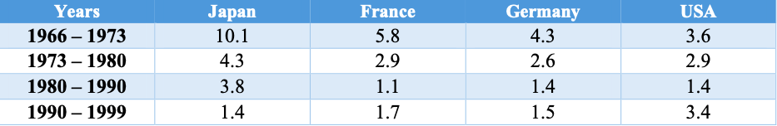
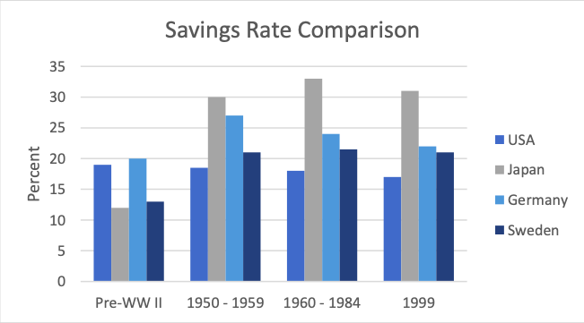
Macroeconomic Performance, Policy and Planning
Notes:
Map
<a href="https://www.freepik.com/free-photos-vectors/business">Business vector created by pikisuperstar - www.freepik.com</a>
Bonsai
<a href="https://www.freepik.com/free-photos-vectors/flower">Flower vector created by macrovector - www.freepik.com</a>
Cheery Blossom
<a href="https://www.freepik.com/free-photos-vectors/banner">Banner vector created by freepik - www.freepik.com</a>

Slide 17
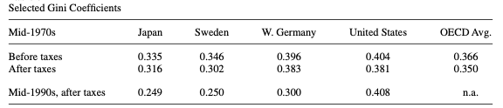
Quality of Life
Relatively Low PPP
Lower crime rates than other countries
Labor Management system led to more equal income distribution
Highly congested cities → Long hours spent in commuting
Notes:
Cheery Blossom
<a href="https://www.freepik.com/free-photos-vectors/banner">Banner vector created by freepik - www.freepik.com</a>
Cat
<a href="https://www.freepik.com/free-photos-vectors/business">Business vector created by pikisuperstar - www.freepik.com</a>

Slide 18

Collapse of Japanese Bubble
Savings Rate
Non-tradable Goods
Tax Cut
Financial Markets
Overinvestments
Capital Leakage
Bad Loans
Work Ethics
Notes:
Background
<a href="http://www.freepik.com">Designed by pikisuperstar / Freepik</a>
Fish
<a href="https://www.freepik.com/free-photos-vectors/flower">Flower vector created by macrovector - www.freepik.com</a>
Cheery Blossom
<a href="https://www.freepik.com/free-photos-vectors/banner">Banner vector created by freepik - www.freepik.com</a>

Slide 19
Thank You
Notes:
<a href="https://www.freepik.com/free-photos-vectors/business">Business vector created by pikisuperstar - www.freepik.com</a>

